Slide 1
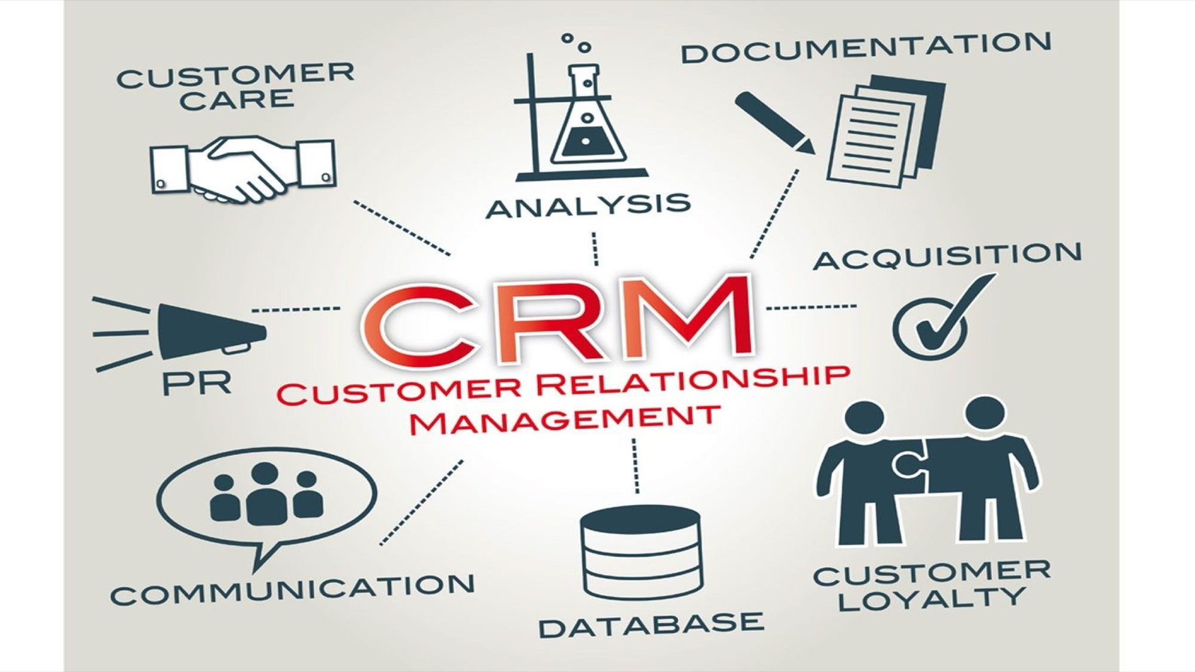
Capstone – Ecommerce CRM Analysis
By Mr. Prasad V. Patil

Slide 2

Project Overview
"Unlocking Customer Insights: A Comprehensive CRM Analysis"
"Leveraging RFM, CLV, and Market Basket Analysis for Strategic Decision Making"
Key Objectives
Segment customers using advanced RFM metrics
Optimize customer retention through CLV analysis
Uncover cross-selling opportunities with Market Basket Analysis

Slide 3

Data Overview and Preprocessing
Dataset:
Number of Observations: 541909
Number of transactions: 8
Key columns: CustomerID, StockCode, Quantity, Monetary, InvoiceDate, InvoiceNo, UnitPrice ,
Description, Country
Data Cleaning:
Removing duplicates:-
Original dataset size: 541,909 rows
Dataset size after removing duplicates: 536,641 rows
Number of duplicates removed: 5,268 (about 0.97% of the original dataset)
Handling missing values:-
Description: 1,454 null values CustomerID: 135,037 null values All other columns have no null values
Imputation done by using ‘Guest’ as a missing CustomerID and ‘Unknown’ inplace of missing Description
Outlier Treatment:-
Outliers are removed from Quantity and Unitprice by using IQR Method
New Features:-
TotalAmount, Recency, Frequency,Monetary, AverageOrderValue, CustomerLifespanMonths,CLV

Slide 4

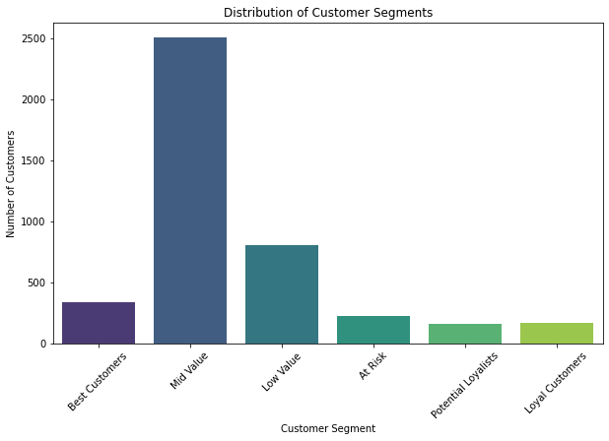
RFM Analysis & Customer Segmentation
Approach: Calculated RFM scores and assigned customer segments based on predefined thresholds.
Segments:
Best Customers: RFM Score 555
Loyal Customers: High Frequency, Moderate Monetary
At Risk Customers: High Recency, Low Frequency and Monetary
Low Value Customers: Consistently low across all dimensions
Key Observations:
Dominant Segment: Large concentration in one customer group
Smaller High-Value Segments: Few customers in top-tier categories
Strategic Implications:
Uplift Strategy:• Target dominant segment with engagement campaigns . Focus on moving customers to higher-value segments
Retention Focus:• Implement VIP treatment for high-value customers . Develop loyalty programs and exclusive offers
Tailored Approach:• Personalize marketing based on segment characteristics . Allocate resources proportionally to segment value

Slide 5

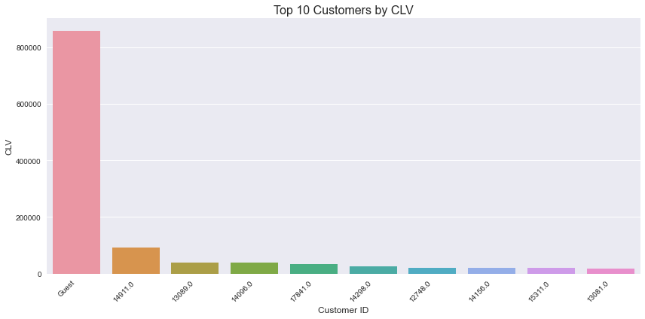
Customer Lifetime Value (CLV) Analysis
CLV is a prediction of the net profit attributed to the entire future relationship with a customer.
Approach: Calculated using TotalRevenue, AverageOrderValue, CustomerLifespanMonths, and PurchaseFrequency.
Key CLV Insights:
Guest Dominance: Unregistered customers lead with 800,000 CLV
Significant Gap: Large disparity between Guest and top individual customer
Individual Leaders: Top registered customer at 100,000 CLV
Value Distribution: Gradual decline from 100,000 to 20,000 CLV among top 10
Registered Impact: Collective value of registered customers remains crucial
Strategic Focus:
Convert high-value Guests to registered users
Implement targeted retention programs for top customers
Nurture and grow CLV of existing registered users
Action Items:
Develop Guest-to-Registered conversion strategy
Create tiered loyalty program for top customers
Analyze and replicate behaviors of high-CLV individuals

Slide 6

Market Basket Analysis
Goal: To identify product categories that are frequently purchased together.
Key Findings:
High Frequency: Categories 22, 21, 23 dominate purchases
Moderate Demand: Categories 84, 20, 85 show significant presence
Niche Markets: Categories 82, 47, 35, 48 cater to specific segments
No Strong Associations: Items often purchased independently
Strategic Recommendations:
For High Frequency Categories:
Focus promotions on top categories
Implement cross-selling strategies
Optimize inventory management
For Moderate Frequency Categories:
Bundle with top-selling items
Analyze complementary product potential
For Niche Categories:
Launch targeted marketing campaigns
Utilize customer segmentation for personalized recommendations

Slide 7

Key Insights from Customer Analysis
CRM Analysis Highlights:
Customer Segmentation (RFM):• 15-20% "Best Customers" drive significant revenue• Large "Low Value" and "At Risk" segments identified• 80/20 rule evident in customer value distribution
Customer Lifetime Value (CLV):• Identified high-value customers for targeted retention• Basis for personalized loyalty programs established
Purchase Patterns:• Categories 22, 21, 23 most frequently purchased• No strong product associations discovered• Cross-category insights guide bundling strategies
Temporal Trends:• Seasonal patterns in purchasing behavior uncovered• Informs marketing timing and inventory management
Strategic Implications:
Focus on retaining and growing "Best Customers“
Develop re-engagement strategies for "At Risk" segment
Optimize product mix and promotions based on top categories
Align marketing and inventory with seasonal trends
Next Steps:
Implement targeted loyalty programs
Launch re-engagement campaigns for at-risk customers
Refine product bundling and cross-selling strategies
Adjust marketing calendar to capitalize on seasonal patterns

Slide 8

Strategic Recommendations
Strategic Action Plan
Boost Loyalty: VIP perks for top customers. Re-engage at-risk segments
Optimize Sales: Bundle top categories. Spotlight Category 22
Smart Growth: Target high-value acquisitions. Nurture existing customers
Precision Marketing: Tailor to RFM segments. Multi-channel engagement
Key Actions:
Launch tiered rewards
Create targeted bundles
Develop segment playbooks
Automate win-back emails
Goals:
↑ Retention
↑ Order value
↑ Marketing ROI
↑ Customer LTV

Slide 9

Conclusion
Key Achievements:
Comprehensive Customer Insights• RFM segmentation revealed value tiers• Market Basket Analysis uncovered purchase patterns
Strategic Tools Developed• Customer value quantification• Cross-selling opportunity identification
Data-Driven Decision Making• Targeted marketing strategies• Informed product positioning
Future Applications:
Personalized marketing campaigns
Optimized product bundles
Tailored loyalty programs
Predictive customer behavior modeling

